Slide 1

World Electricity Analysis

Slide 2
Introduction:
Analysis on production of electricity from various sources.
Analysis on electricity transmission and distribution losses.
Analysis on accessibility of electricity in different countries.
Analysis on urban and rural electricity accessibility.

Slide 3
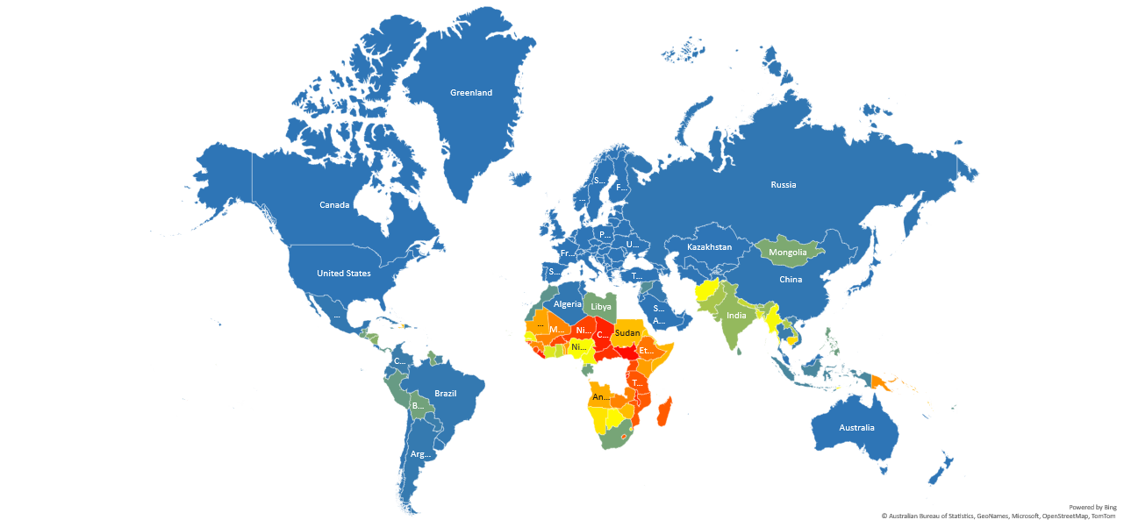
Comparison of access to electricity post 2000s in different countries :

Slide 4
Nuclear power presence grouped by Region :

Slide 5
Findings:
Almost 60% of the countries have electricity accessibility rate of greater then 90%.
Rural areas of more than 100 countries have less than 50% electricity accessibility.
Only 25% countries have the nuclear electricity generation capacity.
All countries are primarily dependent on oil sources to produce electricity.
Less than 10% countries have transmission and distribution losses above 20%.

Slide 6
Insights:
Most African countries need to grow its electricity access in comparison with other parts of the world.
Rural areas require more attention to the lack of accessibility of electricity.
Countries should largely focus on renewable and nuclear sources to produce electricity in order to reduce climatic hazards.
Steps to be taken in order to stop excessive transmission and distribution losses.

Slide 7
Challenges:
Incomplete and inconsistent data.
Lack of knowledge on json files.
Cleaning and handling of datasets.
No prior practice.

Slide 8
Tools & techniques :
Python
SQL
Excel

Slide 9
Conclusion:
We have worked on a dataset having data of production, transmission & distribution and accessibility of electricity in different countries.
We faced a lot of hurdles while doing analysis on the given set of data.
during the process, we had a hands on experience on how to handle such kind of datasets to perform required analysis.
We could learn about team building and collective working in a real environment.
This project wouldn’t have been completed without everyone’s valuable opinions and ideas.

Slide 10
Thank you

